Slide 1
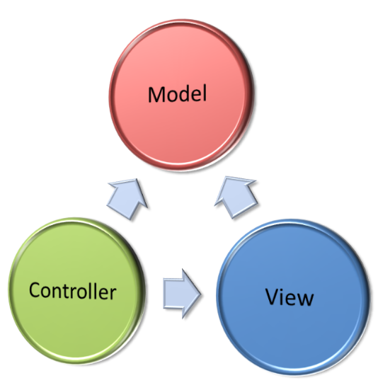
MVC Introduction
Model – View – Controller
SoftUni Team
Technical Trainers
Software University
http://softuni.bg

Slide 2
Table of Contents
MVC Concepts - MVC Pattern Explained
Overview, Purpose
Web App Structure
Front Controller
Data Processing

Slide 3
Have a Question?
sli.do
#php-web

Slide 4
The MVC Pattern
Model-View-Controller

Slide 5
MVC Concept Explained
User
HTTP Request
/Some/Page/
Front controller (dispatcher)
Delegate request
HTTP Response
Controller
Select view & pass data
CRUD operations
View
(render UI)
Model (data)
Use data from
the model

Slide 6
The MVC Pattern
Design pattern with three independent components:
Model (data)
Manages data and database logic
View (UI)
Presentation layer (renders the UI)
Controller (logic)
Implements the application logic
Processes user request, performs an action, updates the data model and invokes a view to render some UI

Slide 7
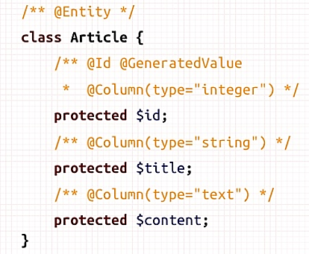
Model (Data)
Set of classes that describes the data we are working with
Rules for how the data can be changed and manipulated
May contain data validation rules
Often encapsulates data stored in a database
As well as code used to manipulate the data
E.g. Data Access Layer of some kind

Slide 8

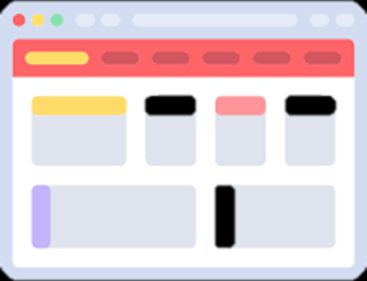

View (UI)
Defines how the application’s user interface (UI) will be displayed
May support master views (layouts)
May support sub-views (partial views or controls)
May use templates to dynamically generate HTML

Slide 9
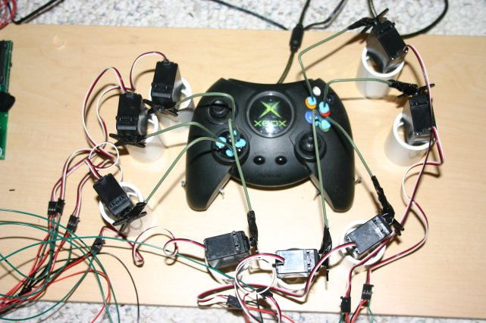
Controller (Logic)
The core MVC component – holds the logic
Process the requests with the help of views and models
A set of classes that handles
Communication from the user
Overall application flow
Application-specific logic (business logic)
Every controller has one or more "actions"

Slide 10

Web App Structure

Slide 11
Web and PHP App Architecture
Web Browser
Web Browser
Presentation
Views: HTML + PHP
Presentation Logic
PHP Controller Classes
Business Logic
PHP Model Classes
Data Access Layer
PHP Data Access Classes
Database
MySQL

Slide 12

Front Controller
ControllerA
View
HTTP Request
Front Controller
ControllerB
View
ControllerC
View
Notes:
What is "front controller"?
Architectural design pattern for Web applications
Front controller == centralized entry point for all requests

Slide 13
Data Access
Database Access Logic
ORM Approach
Direct Access
Map Tables to Classes
Data Access Classes
Notes:
ORM Approach:
$user = $userRepo->findById(4);
$user->setName(“Johnathan”);
$userRepo->save($user);
Direct Access:
$db->query(“UPDATE users SET name = “Johnathan” WHERE id = 4”);

Slide 14
Data Binding
Data Binding
Form Data
View Data
Map Form Data to Objects
Map Variables to ViewModels
Notes:
Form data:
Instead:
public function edit() {
$id = $_GET[‘id’];
$name = $_POST[‘name’];
// do smth
}
do:
public function edit($id, UserBindingModel $user) {
$name = $user->getName();
// do smth
}
View data:
Instead:
public function index() {
$this->view->name = “John”;
$this->view->age = 24;
}
do:
public function index() {
$userViewModel = new UserViewModel(“John”, 24);
return view($userViewModel);
}

Slide 15

Summary
…
…
…
MVC Design Pattern
Web Structure
PHP Structure

Slide 16
https://softuni.bg/courses/php-mvc-frameworks

Slide 17













SoftUni Diamond Partners

Slide 18





SoftUni Organizational Partners

Slide 19




Trainings @ Software University (SoftUni)
Software University – High-Quality Education and Employment Opportunities
softuni.bg
Software University Foundation
http://softuni.foundation/
Software University @ Facebook
facebook.com/SoftwareUniversity
Software University Forums
forum.softuni.bg

Slide 20

License
This course (slides, examples, demos, videos, homework, etc.) is licensed under the "Creative Commons Attribution-NonCommercial-ShareAlike 4.0 International" license

